Slide 1
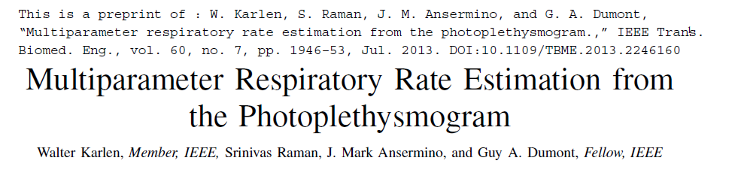
FEATURE EXTRACTION FROM PPG DATA
Estimation of respiration rates from Photoplethysmographic (PPG) signals

Slide 2
Three respiratory induced variations(frequency, intensity, and amplitude) are extracted from the PPG using the Incremental-Merge Segmentation algorithm. Frequency content of each respiratory induced variation is analyzed using Fast Fourier Transforms.
We present a novel real-time algorithm for segmentation of the PPG into pulses and for the classification of artifacts. The Incremental-Merge Segmentation (IMS) algorithm operates in the time domain and extracts morphological features of the PPG. These features are line segments that are classified as pulses or artifacts using adaptive thresholds. The IMS algorithm was evaluated using the Complex System Laboratory (CSL) Benchmark dataset. A sensitivity of 98.93% and positive predictive value of 96.68% have been obtained, which compares very favorably with the CSL benchmark algorithm. The novel algorithm is currently being implemented into mobile phone pulse oximeters

Slide 3
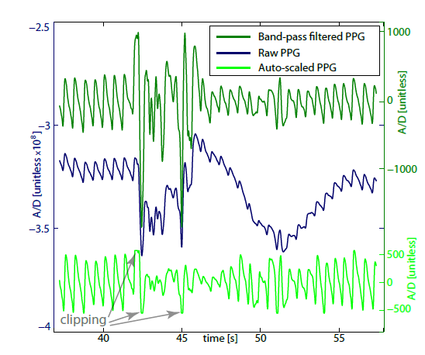
Fig. 1. PPG signal at different processing stages corrupted by artifacts.
With auto-scaled signals, clipping occurs during artifacts and large baselineshifts

Slide 4
The raw PPG waveform is characterized by an AC component
that corresponds to the heart beat induced variation
of blood volume in the arteries and a DC component that
corresponds to the constant amount of absorption from predominantly
tissues and non-pulsatile venous blood. Only the
AC component is relevant for the extraction of the heart beat.
However, artifacts can be recognized in both the AC and DC
components (Fig. 1). Artifacts are frequently accompanied by
a large rapid fluctuation of the DC component. Unfortunately,
most commercial pulse oximeter devices provide only a
band-pass filtered and/or auto-scaled PPG signal where the
original DC component has been eliminated and is not visible
to the user. In these heavily filtered situations the PPG signal
frequently becomes saturated and clipped due to artifacts and
baseline shifts

Slide 5
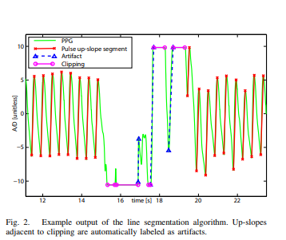

Slide 6
Determination of Heart Rate from Photoplethysmogram using Fast Fourier Transform
Introduction
heart rate measurement using frequency obtained from Fast Fourier Transform analysis and peak of the time-domain signal.
the Fast Fourier Transform analysis is reliable for heart rate measurement and the algorithm proposed in this study can be embedded in pulse oximeter to provide heart rate of anesthetic patients.
This study presents a new and simple method of measuring the heart rate from PPG of anesthetic patient using Fast Fourier Transform (FFT). The advantage of FFT is that it is able to reveal the signal frequency from the recorded signal.
By using FFT, the correct heart rate measurement can be achieved once the signal frequency is obtained.

Slide 7
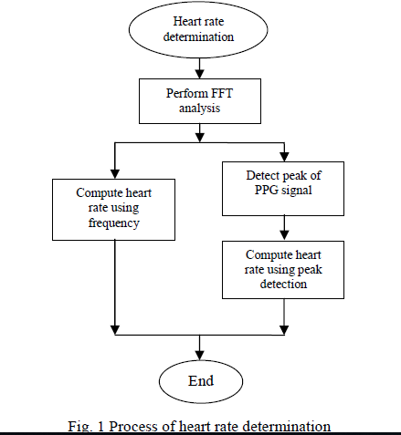

Slide 8
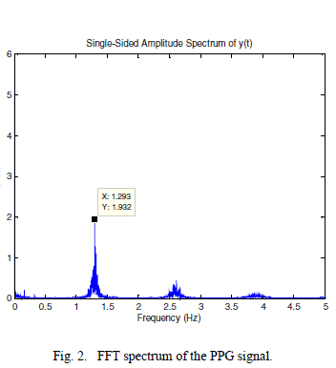
FFT OF PPG SIGNAL

Slide 9
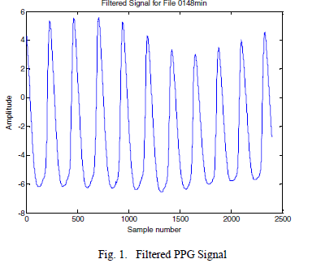
Filtered signal

Slide 10
Determination of Heart Rate using Peak
the peak of the PPG was initially detected automatically using a program written in Matlab. Here, the peak was detected by eliminating the unwanted peak which is below the threshold value.
The threshold value was set to zero because the negative peak cannot be counted as a peak.

Slide 11
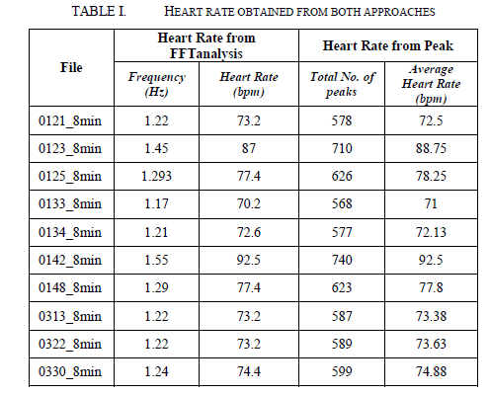
CONCLUSION

Slide 12
The results obtained from this study shows that the heart rate produced from FFT analysis is lower than that obtained from peak. However, since the difference between the heart rate obtained from both methods is considered as small, it can be concluded that the FFT analysis can be used to measure heart rate from PPG of anesthetic patients.

